Slide 1
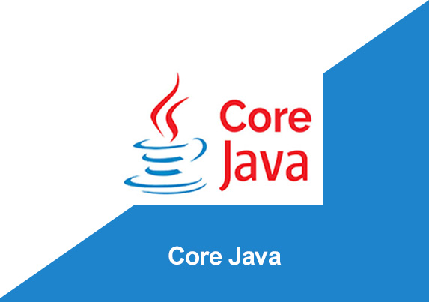
By: Manas Tuwani

Slide 2
INTERFACES
Like a class, an interface can have methods and variables, but the methods declared in interface are by default abstract (only method signature, no body).
Interface is a collection of abstract methods.
Interfaces specify what a class must do and not how. It is the blueprint of the class.
To declare an interface, use interface keyword. It is used to provide total abstraction. That means all the methods in interface are declared with empty body and are public by default.
A class that inherit the interface must implement all the methods declared in the interface. To inherit interface use ‘implements’ keyword.

Slide 3
Interfaces have the following properties
An interface is implicitly abstract. You do not need to use the abstract keyword while declaring an interface.
Each method in an interface is also implicitly abstract, so the abstract keyword is not needed.
Methods in an interface are implicitly public.

Slide 4
How to declare an interface?
An interface is declared by using the interface keyword. It provides total abstraction; means all the methods in an interface are declared with the empty body. A class that implements an interface must implement all the methods declared in the interface.
Syntax:
interface <interface_name> {
// declare constant fields
// declare methods that abstract.
}

Slide 5
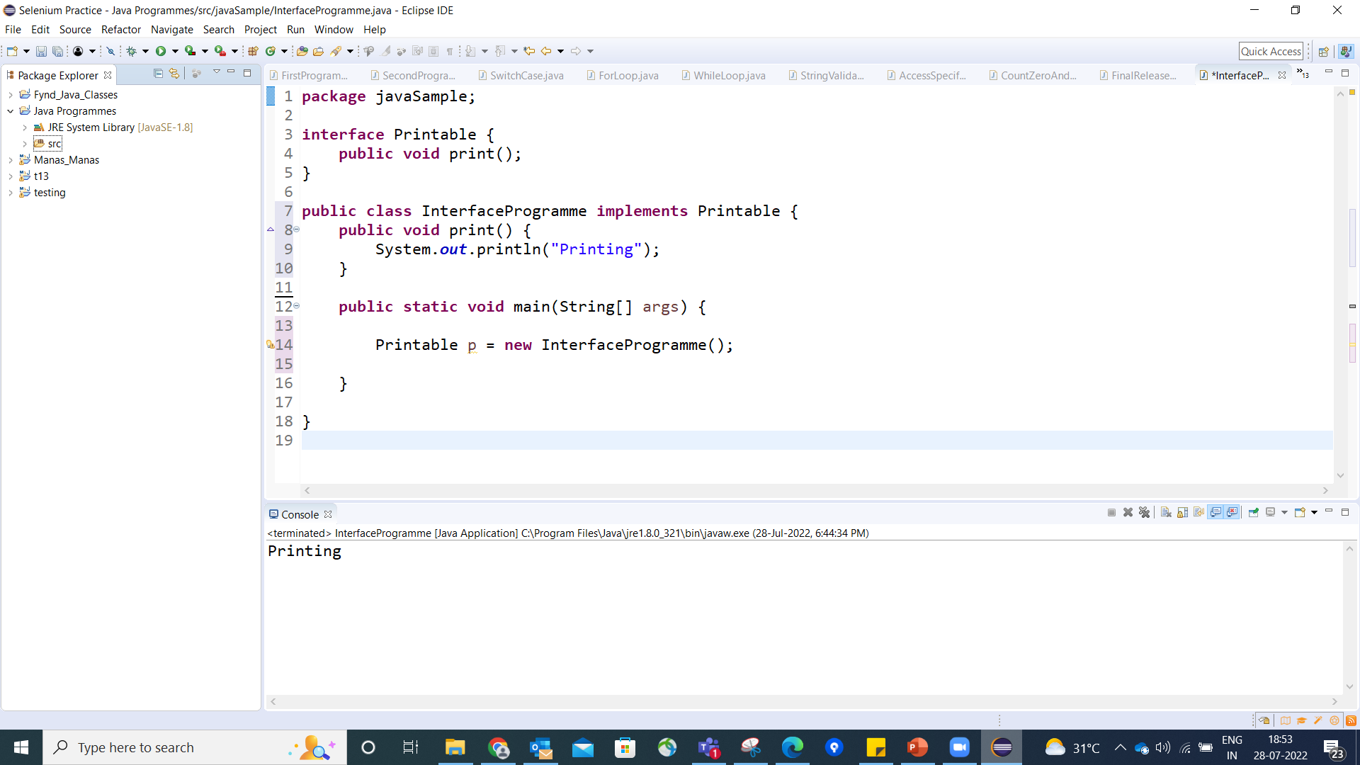
Java Interface Example

Slide 6
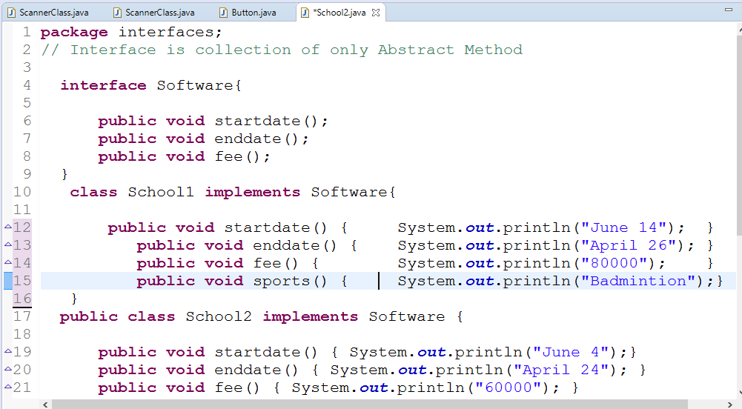

Slide 7
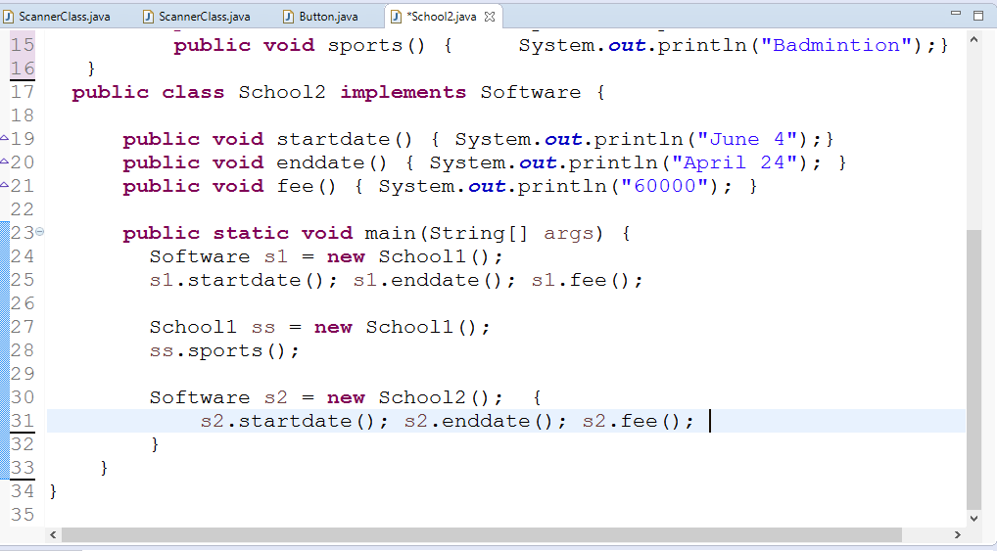

Slide 8


Slide 9
Why do we use interface ?
It is used to achieve total abstraction.
By interface, we can support the functionality of multiple inheritance.

Slide 10
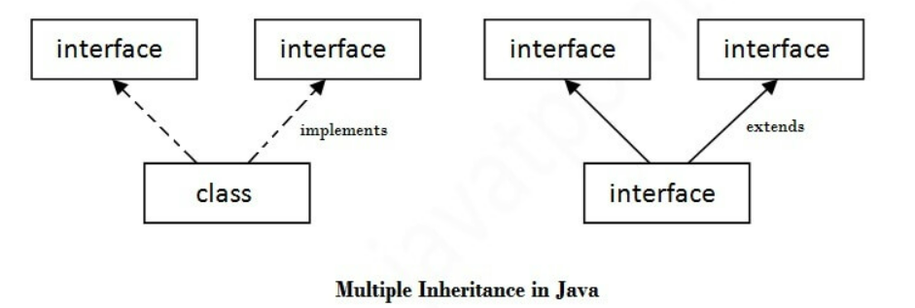
Multiple inheritance in Java by interface
If a class implements multiple interfaces, or an interface extends multiple interfaces, it is known as multiple inheritance.
Class -> Class = Extends
Class -> Interface = Implements
Interface -> Class = Implements
Interface -> Interface = Extends

Slide 11
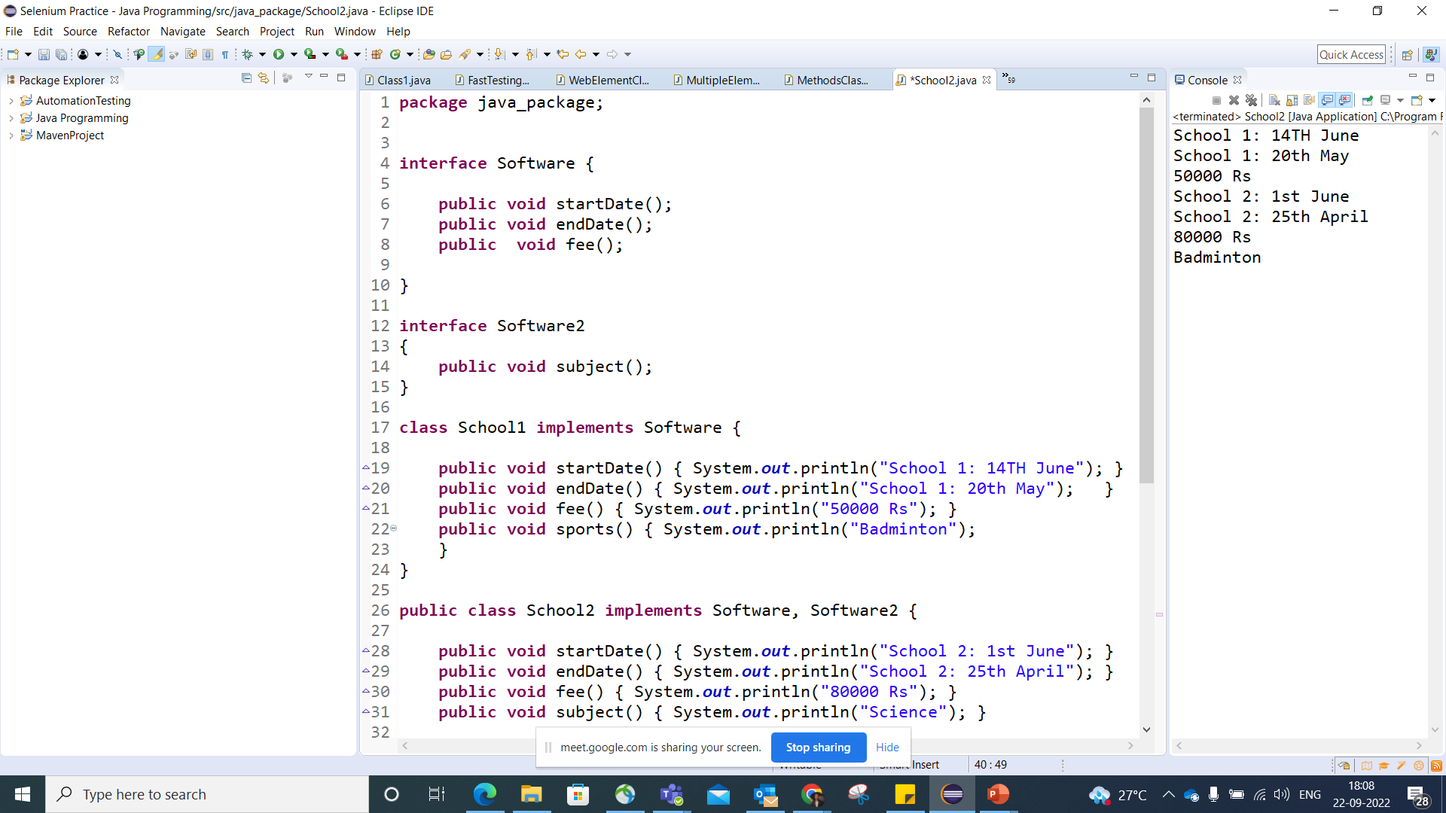

Slide 12
